Slide 1
Lecture-2 Advanced Processor Technology

Slide 2
Single-core computer

Slide 3
Single-core computer(cont..)
A single-core processor is a microprocessor with a single core on a chip, running a single thread at any one time. For example, Intel released a Core 2 Solo and Core 2 Duo, and one would refer to the former as the 'single-core' variant. Most microprocessors prior to the multi-core era are single-core.
What is single core used for?
The single core performance is the performance a CPU would have if you disabled all except one of its cores. It's important because not all programs or games can just run faster by using more cores; some things are going to be limited by the performance of just one core, or just two cores,

Slide 4
Single-core computer(cont..)
What is the difference between single core and multicore processor?
A core is a single processing unit, multi-core processors have multiple processing units.
Is single core performance important?
Single core performance is more important than multi-core performance in MOST games. Games are becoming more and more able to take full advantage of more than one CPU core and individual threads to the point of the multi-threaded applications.

Slide 5
Single-core computer(cont..)
What is the fastest single core processor?
The 10th Gen Intel Core S-series for desktops, and the Intel Core i9-10900K processor, the world's fastest gaming processor reinforces our commitment to the gaming and enthusiast communities.
What is a good single core score?
Ranking of single-core processors by Geekbench score performance worldwide 2020. As of October 2020, the Intel Core i7-1165G7 processor achieved the best average single-core performance with a score of 1,474 from the Geekbench benchmarking tests.

Slide 6
Single-core computer(cont..)
Is quad core faster than single core?
Yes, quad-core CPUs are generally much faster than single-core CPUs even if the single-core CPU has a faster clock speed. A quad-core CPU is actually constructed of four separate processors squashed on to a single chip.
Are single core processors still available?
Single-core – one processor on a die. Since about 2012, even most smart phone CPUs marketed are no longer single-core; Microcontrollers are still single-core, while there are exceptions. Multi-core – a 'few' processors on a die, e.g. 2, 4, 8.

Slide 7
Single-core CPU chip
the single core

Slide 8
Hyper-Threading
Hyper-threading was Intel’s first attempt to bring parallel computation to consumer PCs.
It debuted on desktop CPUs with the Pentium 4 HT back in 2002.
The Pentium 4’s of the day featured just a single CPU core, so it could really only perform one task at a time—even if it was able to switch between tasks quickly enough that it seemed like multitasking.
Hyper-threading attempted to make up for that.

Slide 9
Hyper-Threading (cont..)
A single physical CPU core with hyper-threading appears as two logical CPUs to an operating system.
The CPU is still a single CPU, so it’s a little bit of a cheat.
While the operating system sees two CPUs for each core, the actual CPU hardware only has a single set of execution resources for each core.
The CPU pretends it has more cores than it does, and it uses its own logic to speed up program execution.
In other words, the operating system is tricked into seeing two CPUs for each actual CPU core.

Slide 10
Hyper-Threading (cont..)
Hyper-threading allows the two logical CPU cores to share physical execution resources.
This can speed things up somewhat—if one virtual CPU is stalled and waiting, the other virtual CPU can borrow its execution resources.
Hyper-threading can help speed your system up, but it’s nowhere near as good as having actual additional cores.

Slide 11
Hyper-Threading (cont..)
Thankfully, hyper-threading is now a “bonus.” While the original consumer processors with hyper-threading only had a single core that masqueraded as multiple cores, modern Intel CPUs now have both multiple cores and hyper-threading technology.
Your dual-core CPU with hyper-threading appears as four cores to your operating system, while your quad-core CPU with hyper-threading appears as eight cores.
Hyper-threading is no substitute for additional cores, but a dual-core CPU with hyper-threading should perform better than a dual-core CPU without hyper-threading.

Slide 12
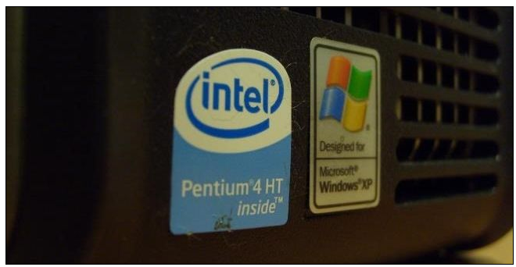
Hyper-Threading (cont..)

Slide 13
Multi-core architectures
This lecture is about a new trend in computer architecture: Replicate multiple processor cores on a single die.
Core 1
Core 2
Core 3
Core 4
Multi-core CPU chip
Notes:
A multi-core processor is a computer processor integrated circuit with two or more separate processing units, called cores, each of which reads and executes program instructions, as if the computer had several processors.
What does it mean to have 4 cores?
A quad-core CPU has four processing cores in a single chip. It is similar to a dual-core CPU, but has four separate processors (rather than two), which can process instructions at the same time. Some examples of quad-core CPUs include the Intel Core 2 Quad, Intel Nehalem, and AMD Phenom X4 processors.
What is multi core good for?
A CPU that offers multiple cores may perform significantly better than a single-core CPU of the same speed. Multiple cores allow PCs to run multiple processes at the same time with greater ease, increasing your performance when multitasking or under the demands of powerful apps and programs.
How do multiple cores work? A dual-core CPU has two central processing units, so it appears to the operating system as two CPUs. A CPU with two cores, for example, could run two different processes at the same time. This speeds up your system, because your computer can do multiple things at once.

Slide 14
Multiple Cores
Originally, CPUs had a single core.
That meant the physical CPU had a single central processing unit on it.
To increase performance, manufacturers add additional “cores,” or central processing units.
A dual-core CPU has two central processing units, so it appears to the operating system as two CPUs.
A CPU with two cores, for example, could run two different processes at the same time.
This speeds up your system, because your computer can do multiple things at once.

Slide 15
Multiple Cores (cont..)
Unlike hyper-threading, there are no tricks here — a dual-core CPU literally has two central processing units on the CPU chip.
A quad-core CPU has four central processing units, an octa-core CPU has eight central processing units, and so on.

Slide 16
Multiple Cores (cont..)
This helps dramatically improve performance while keeping the physical CPU unit small so it fits in a single socket.
There only needs to be a single CPU socket with a single CPU unit inserted into it—not four different CPU sockets with four different CPUs, each needing their own power, cooling, and other hardware.
There’s less latency because the cores can communicate more quickly, as they’re all on the same chip

Slide 17
Multiple Cores (cont..)
Windows’ Task Manager shows this fairly well.
Here, for example, you can see that this system has one actual CPU (socket) and four cores.
Hyperthreading makes each core look like two CPUs to the operating system, so it shows 8 logical processors.

Slide 18
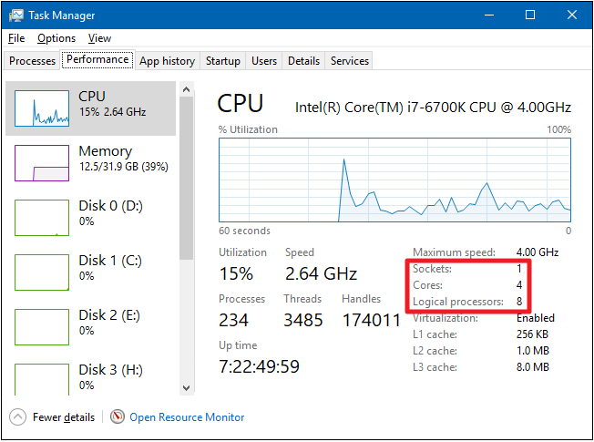
Multiple Cores (cont..)

Slide 19
Multiple CPUs
Most computers only have a single CPU.
That single CPU may have multiple cores or hyper-threading technology.
But it’s still only one physical CPU unit inserted into a single CPU socket on the motherboard.

Slide 20
Multiple CPUs (cont..)
Before hyper-threading and multi-core CPUs came around, people attempted to add additional processing power to computers by adding additional CPUs.
This requires a motherboard with multiple CPU sockets.
The motherboard also needs additional hardware to connect those CPU sockets to the RAM and other resources.
There’s a lot of overhead in this kind of setup.
There’s additional latency if the CPUs need to communicate with each other, systems with multiple CPUs consume more power, and the motherboard needs more sockets and hardware.

Slide 21
Multiple CPUs (cont..)
Systems with multiple CPUs aren’t very common among home-user PCs today.
Even a high-powered gaming desktop with multiple graphics cards will generally only have a single CPU.
You’ll find multiple CPU systems among supercomputers, servers, and similar high-end systems that need as much number-crunching power as they can get.

Slide 22
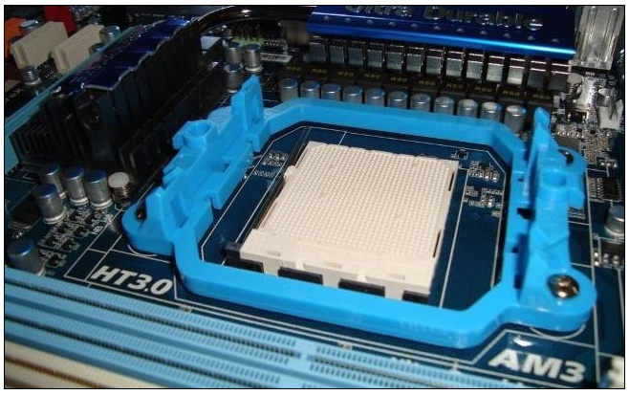
Multiple CPUs (cont..)

Slide 23
Multiple CPUs (cont..)
The more CPUs or cores a computer has, the more things it can do at once, helping improve performance on most tasks.
Most computers now have CPUs with multiple cores—the most efficient option we’ve discussed.
You’ll even find CPUs with multiple cores on modern smart phones and tablets.
Intel CPUs also feature hyper-threading, which is kind of a bonus.
Some computers that need a large amount of CPU power may have multiple CPUs, but it’s much less efficient than it sounds.

Slide 24
Multi-core CPU chip
The cores fit on a single processor socket
Also called CMP (Chip Multi-Processor)
core
1
core
2
core
3
core
4

Slide 25
The cores run in parallel
thread 1
thread 2
thread 3
thread 4
core
1
core
2
core
3
core
4

Slide 26
Within each core, threads are time-sliced (just like on a uniprocessor)
several threads
several threads
several threads
several threads
core
1
core
2
core
3
core
4

Slide 27
Interaction with the Operating System
OS perceives each core as a separate processor
OS scheduler maps threads/processes to different cores
Most major OS support multi-core today: Windows, Linux, Mac OS X, …
Is Intel Core i5 multicore?
The Core i3 range is entirely dual core, while Core i5 and i7 processors have four cores.It is difficult for an application to take advantage of the multicore system. ... Having multiple cores means that the computer can work on more than one task at a time more efficiently.

Slide 28

Why multi-core ?
Difficult to make single-core clock frequencies even higher
Deeply pipelined circuits:
heat problems
speed of light problems
difficult design and verification
large design teams necessary
server farms need expensive air-conditioning
Many new applications are multithreaded
General trend in computer architecture (shift towards more parallelism)

Slide 29
Instruction-level parallelism
Parallelism at the machine-instruction level
The processor can re-order, pipeline instructions, split them into microinstructions, do aggressive branch prediction, etc.
Instruction-level parallelism enabled rapid increases in processor speeds over the last 15 years

Slide 30
Thread-level parallelism (TLP)
This is parallelism on a more coarser scale
Server can serve each client in a separate thread (Web server, database server)
A computer game can do AI, graphics, and physics in three separate threads
Single-core superscalar processors cannot fully exploit TLP
Multi-core architectures are the next step in processor evolution: explicitly exploiting TLP

Slide 31

General context: Multiprocessors
Multiprocessor is any computer with several processors
SIMD
Single instruction, multiple data
Modern graphics cards
MIMD
Multiple instructions, multiple data
Lemieux cluster, Pittsburgh supercomputing center

Slide 32
Multiprocessor memory types
Shared memory: In this model, there is one (large) common shared memory for all processors
Distributed memory: In this model, each processor has its own (small) local memory, and its content is not replicated anywhere else

Slide 33
Multi-core processor is a special kind of a multiprocessor: All processors are on the same chip
Multi-core processors are MIMD: Different cores execute different threads (Multiple Instructions), operating on different parts of memory (Multiple Data).
Multi-core is a shared memory multiprocessor: All cores share the same memory

Slide 34
What applications benefit from multi-core?
Database servers
Web servers (Web commerce)
Compilers
Multimedia applications
Scientific applications, CAD/CAM
In general, applications with Thread-level parallelism (as opposed to instruction-level parallelism)
Each can run on its own core

Slide 35
More examples
Editing a photo while recording a TV show through a digital video recorder
Downloading software while running an anti-virus program
“Anything that can be threaded today will map efficiently to multi-core”
BUT: some applications difficult to parallelize

Slide 36
A technique complementary to multi-core: Simultaneous multithreading
Problem addressed: The processor pipeline can get stalled:
Waiting for the result of a long floating point (or integer) operation
Waiting for data to arrive from memory
Other execution units wait unused
L1 D-Cache D-TLB
Integer
Floating Point
Schedulers
L2 Cache and Control
Uop queues
Rename/Alloc
BTB
Trace Cache
uCode ROM
Decoder
Bus
BTB and I-TLB
Source: Intel

Slide 37
Simultaneous multithreading (SMT)
Permits multiple independent threads to execute SIMULTANEOUSLY on the SAME core
Weaving together multiple “threads” on the same core
Example: if one thread is waiting for a floating point operation to complete, another thread can use the integer units

Slide 38
SMT not a “true” parallel processor
Enables better threading (e.g. up to 30%)
OS and applications perceive each simultaneous thread as a separate “virtual processor”
The chip has only a single copy of each resource
Compare to multi-core: each core has its own copy of resources

Slide 39
Multi-core: threads can run on separate cores
L1 D-Cache D-TLB
L1 D-Cache D-TLB
Integer
Floating Point
Integer
Floating Point
Schedulers
Schedulers
L2 Cache and Control
Uop queues
L2 Cache and Control
Uop queues
Rename/Alloc
Rename/Alloc
BTB
Trace Cache
uCode ROM
BTB
Trace Cache
uCode ROM
Decoder
Decoder
Bus
BTB and I-TLB
Bus
BTB and I-TLB
Thread 1
Thread 2

Slide 40
Multi-core: threads can run on separate cores
L1 D-Cache D-TLB
L1 D-Cache D-TLB
Integer
Floating Point
Integer
Floating Point
Schedulers
Schedulers
L2 Cache and Control
Uop queues
L2 Cache and Control
Uop queues
Rename/Alloc
Rename/Alloc
BTB
Trace Cache
uCode ROM
BTB
Trace Cache
uCode ROM
Decoder
Decoder
Bus
BTB and I-TLB
Bus
BTB and I-TLB
Thread 3
Thread 4

Slide 41
Combining Multi-core and SMT
Cores can be SMT-enabled (or not)
The different combinations:
Single-core, non-SMT: standard uniprocessor
Single-core, with SMT
Multi-core, non-SMT
Multi-core, with SMT: our fish machines
The number of SMT threads: 2, 4, or sometimes 8 simultaneous threads
Intel calls them “hyper-threads”

Slide 42
SMT Dual-core: all four threads can run concurrently
L1 D-Cache D-TLB
L1 D-Cache D-TLB
Integer
Floating Point
Integer
Floating Point
Schedulers
Schedulers
L2 Cache and Control
Uop queues
L2 Cache and Control
Uop queues
Rename/Alloc
Rename/Alloc
BTB
Trace Cache
uCode ROM
BTB
Trace Cache
uCode ROM
Decoder
Decoder
Bus
BTB and I-TLB
Bus
BTB and I-TLB
Thread 1
Thread 3
Thread 2
Thread 4

Slide 43
Comparison: multi-core vs SMT
Advantages/disadvantages?

Slide 44
Comparison: multi-core vs SMT
Multi-core:
Since there are several cores, each is smaller and not as powerful (but also easier to design and manufacture)
However, great with thread-level parallelism
SMT
Can have one large and fast superscalar core
Great performance on a single thread
Mostly still only exploits instruction-level parallelism

Slide 45
The memory hierarchy
If simultaneous multithreading only:
all caches shared
Multi-core chips:
L1 caches private
L2 caches private in some architectures and shared in others
Memory is always shared

Slide 46
“Fish” machines
hyper-threads
Dual-core Intel Xeon processors
Each core is hyper-threaded
Private L1 caches
Shared L2 caches
C O R E 1
C O R E 0
L1 cache
L1 cache
L2 cache
memory

Slide 47
Designs with private L2 caches
C O R E 1
C O R E 0
C O R E 1
C O R E 0
L1 cache
L1 cache
L1 cache
L1 cache
L2 cache
L2 cache
L2 cache
L2 cache
L3 cache
L3 cache
memory
memory
Both L1 and L2 are private
Examples: AMD Opteron, AMD Athlon, Intel Pentium D
A design with L3 caches Example: Intel Itanium 2

